Slide 1

Cigna Pharmacy
Kimley-Horn

Slide 2
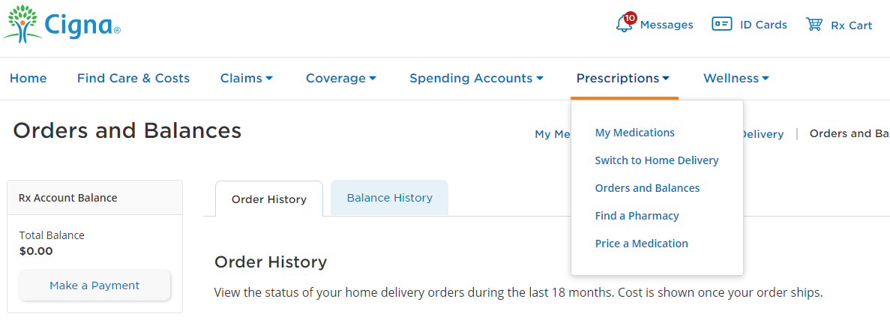
Prescriptions

Slide 3
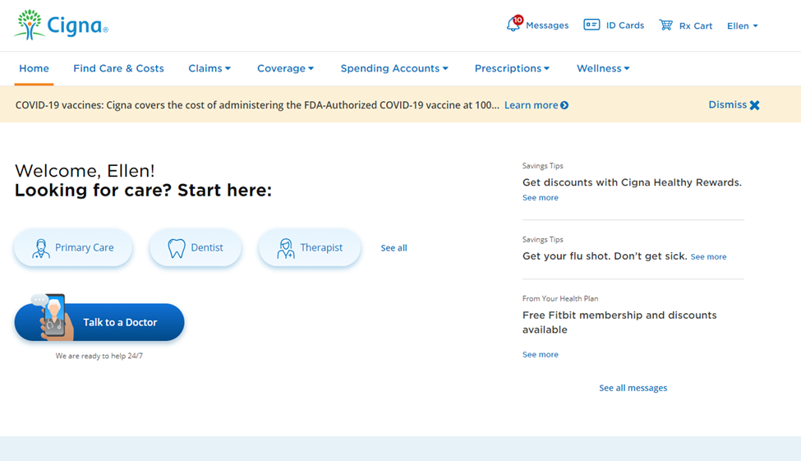
Rx Cart

Slide 4
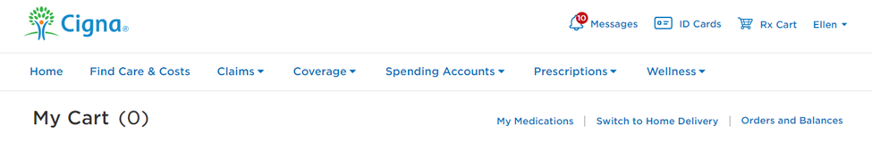

Rx Cart

Slide 5
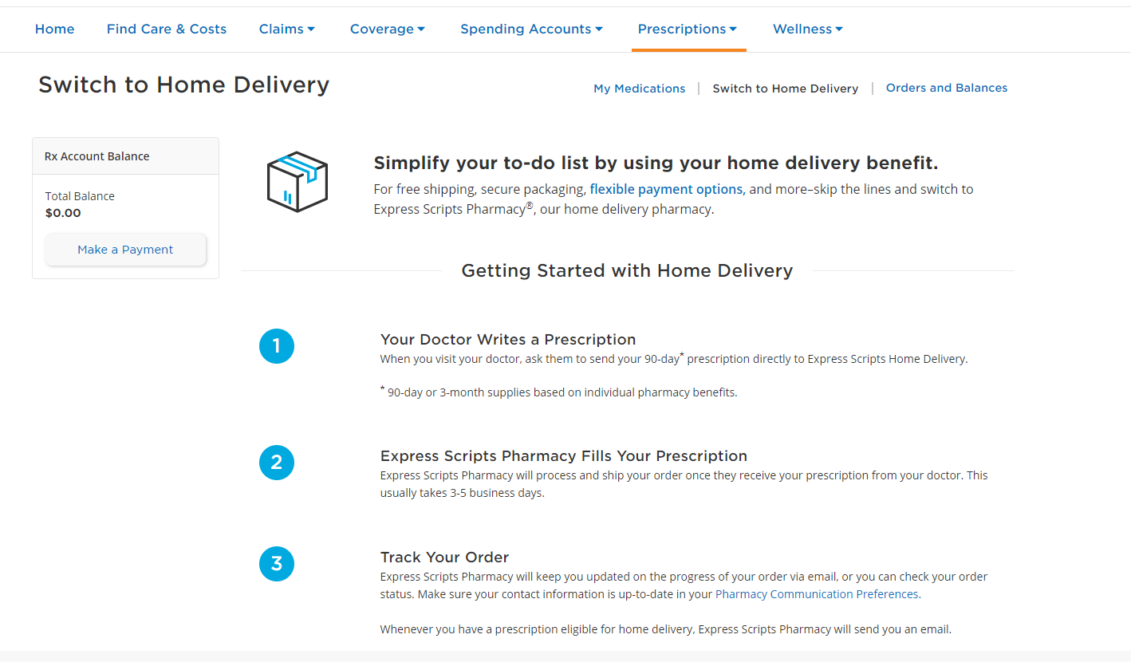
Switch to Home Delivery

Slide 6
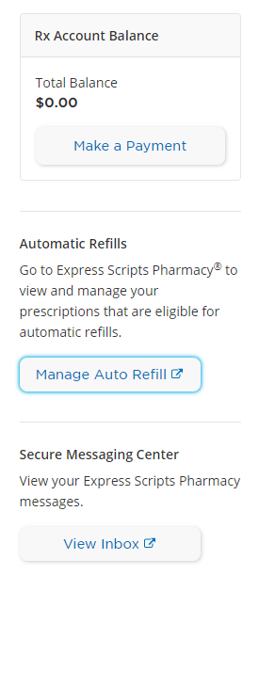

Automatic Refills with Express Scripts Pharmacy

Slide 7
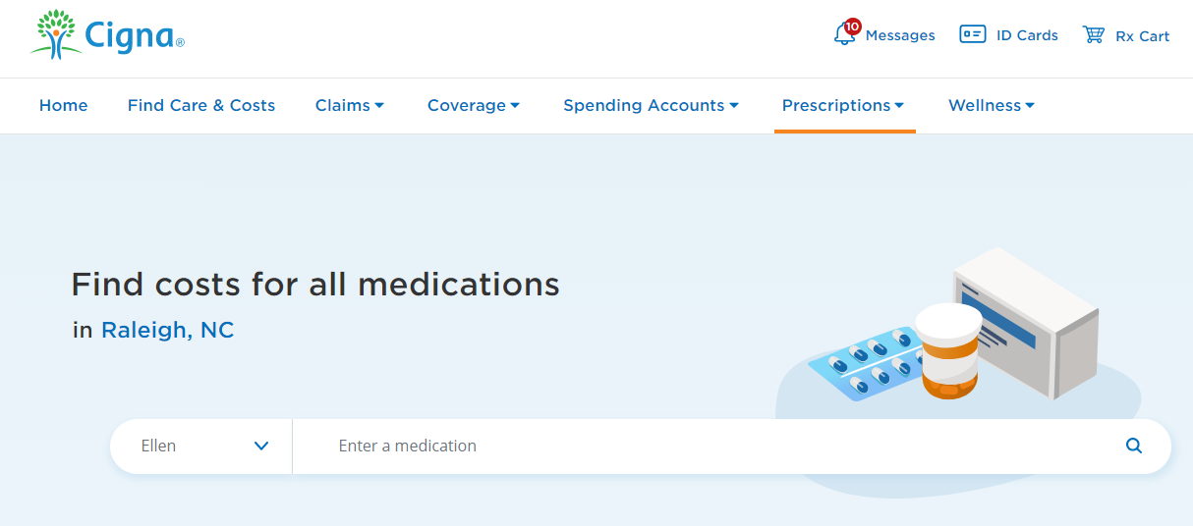
Find costs of medications

Slide 8
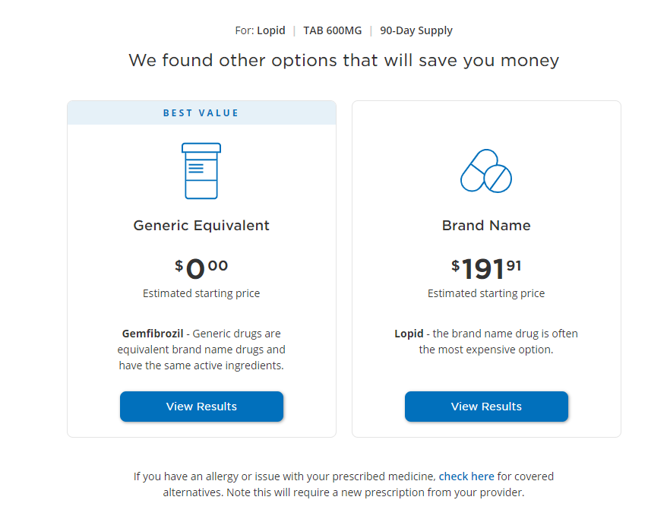
Example cost comparison

